Slide 1


School of
Science, Technology, Engineering, Mathematics
Burl Yearwood – Dean, STEM
Fatma Tat – Coordinator, S-STEM program at HCCC
Fidelis Foda-Kahouo – Coordinator, B2B-NNJ program at HCCC
Board of Trustees
February 21st, 2023

Slide 2
S-STEM:
A sustainable Pathways from Community College to Bachelor's Degree for Urban Youth in STEM
Notes:
Hello everyone. I am Fatma Tat, a chemistry instructor at HCCC and the S-STEM Scholarship Site Coordinator. I am so excited to be here and talk about S-STEM Scholarship.

Slide 3
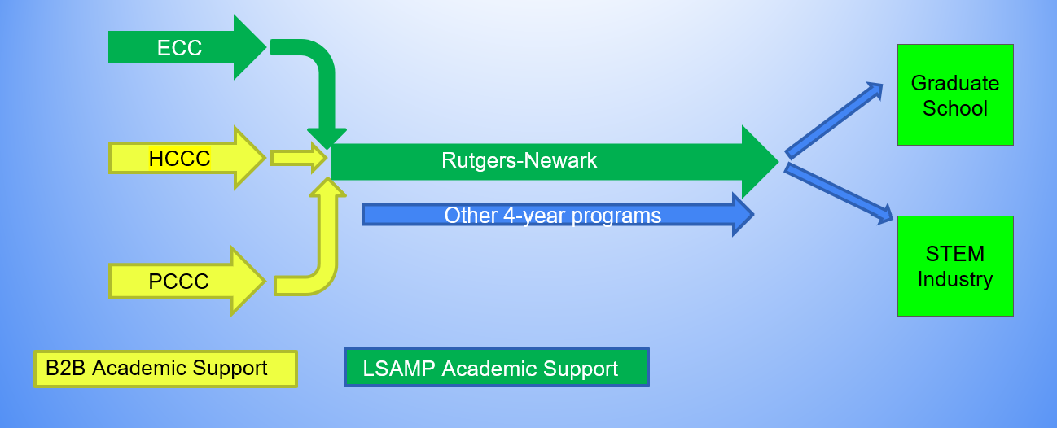
Goals of S-STEM Program
Goals of S-STEM Program
Goal 1: Establish a system of scholarships and academic support for low-income, academically talented minority students in STEM with demonstrated financial need
Goal 2: Build pipelines for S-STEM Scholars from community colleges to 4-year schools and from Baccalaureates to graduate study and careers
Goal 3: Building and maintaining an S-STEM learning community both within and across alliance campuses

Slide 4
S-STEM Program Eligibility Criteria
US Citizen or Green card holder
Full-time student and must have completed at least one semester
Minimum GPA of 3.50 in non-medical STEM field
Underrepresented Minority
    African American
    American Indian or Alaska Native
    Hispanic or Latino
    Native Hawaiian or Pacific Islander
• Must be Pell Grant recipient
• Availability to participate in S-STEM activities

Slide 5
S-STEM Program Common Activities
Common activities for students:
Research experiences
Cross-campus peer mentoring
S-STEM Learning Communities
Advising and Recruiting from site coordinator
Rutgers University speaker series
Louis Stokes Alliances for Minority Participation (LSAMP)/ Bridges to the Baccalaureate (B2B) related activities (Annual STEM Research Conference, Annual Transfer Fair, You got This Event etc.)
130 S-STEM scholarship awards (each award is $2000) were provided to HCCC students from 2018 to present.

Slide 6

Fidelis Foda-Kahouo
NNJ-B2B coordinator

Slide 7
Program Goals
To ensure the successful transfer of community college STEM students to 4-year institutions by:
Building multiple bridges between students and the ranks of their 4-year counterparts
Developing a larger cross-campus learning community built on:
  Undergraduate research
  Internships
  4-year faculty engagement
  Cross-campus peer mentoring
Supporting Paid Campus Activities
  Speaker Series
  Conferences
  B2B Club Meetings
  Peer Mentoring and Tutoring
  Assistance in recruitment efforts
  Assistance in Labs and lectures

Slide 8
NNJ-B2B Eligibility Criteria
Must belong to a federally recognized Under –Represented Minority group (URM)
Must be a US citizen or Permanent Resident
Must be in a non- medical STEM major
Must have completed at least one semester
Must be a full-time student
Federally recognized Under-Represented Minority Groups include:
    Black
    American Indian or Alaska Native
    Hispanic or Latino
    Native Hawaiian
    Pacific Islander

Slide 9
STEM Under-Represented Minority Transfer Rate
 | Total | Transferred to a 4-year institution | Transfer Rate
STEM URM Graduates, 2020-21 | 264 | 155 | 59%
URM | 151 | 92 | 61%
Non-URM | 113 | 63 | 56%
B2B Program | 19 | 19 | 100%

Slide 10
NNJ-B2B Success Stories
Jakita Crawford: HCCC Class of 2021
Daniel Menendez: HCCC Class of 2022

Slide 11
THANK YOU!
QUESTIONS?

